Slide 1
Analysis Report
By-Vishal Kamble

Slide 2
Outline
Data Preprocessing
Data Visualization
Inferences

Slide 3
Data Preprocessing
Created a Excel Macro template to remove the ambiguities in the Data Set.
Macro Program will do following.
Correct the typo errors.
Create Pivot table to measure the Program Performance.
Create Graph to compare program performance
Program details between 7.00 am to 8.00 am are missing in the data set.

Slide 4
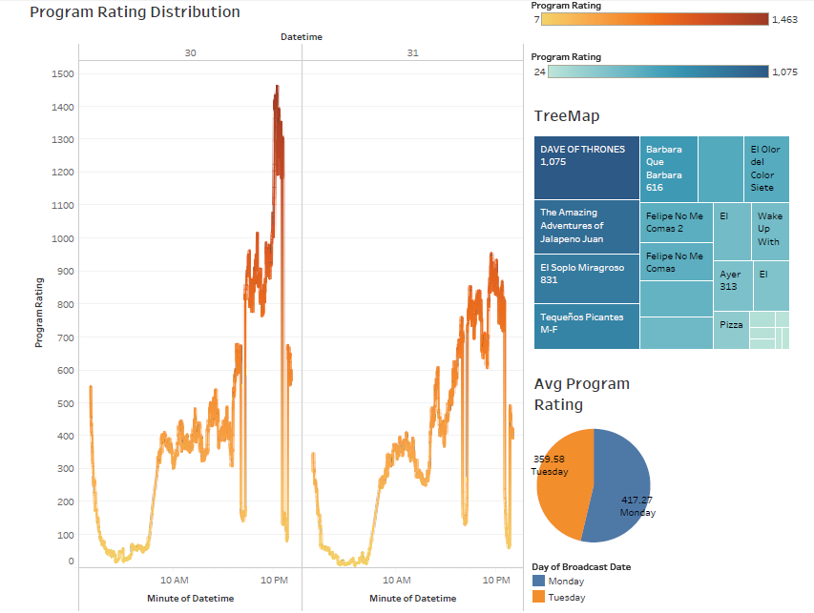
Program Rating Distribution over two days

Slide 5
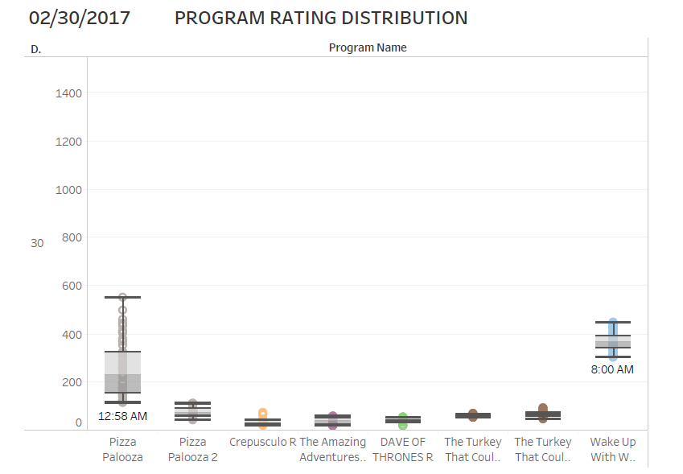
Mid night and Repeat Telecast Show Performance
Performances for repeat telecast shows are lower than average rating.
Constant Performance for both days
Performance start increasing with show Wake Up With Waffles at 8.00 am

Slide 6
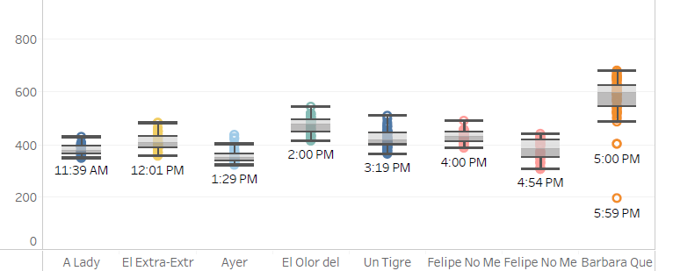
Average rating performances for Afternoon shows are similar and constant
Starting performance for Barbara Que Barbara is lower than average performance of show

Slide 7
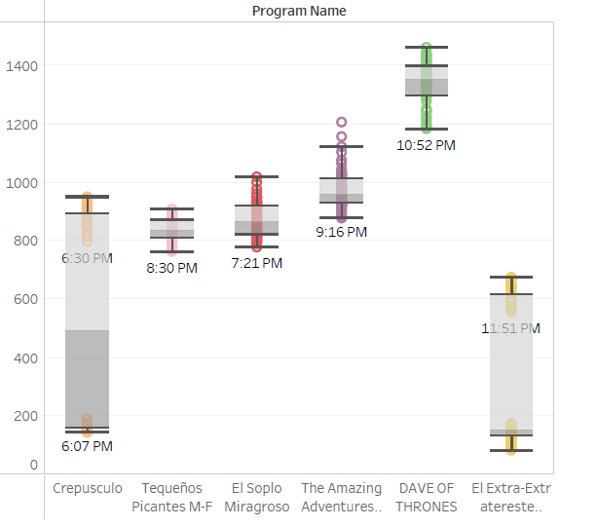
Performances of shows increases at Prime Time
Rating for show Crepusculo is not constant and widely distributed.
DAVE OF THRONES is the most popular TV show

Slide 8
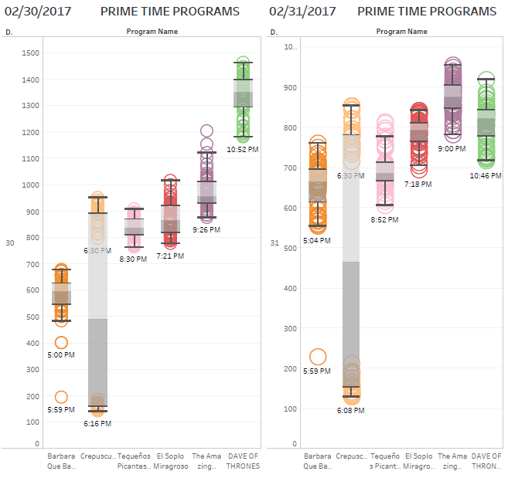
For TV show Crepuscul, 17% drop average rating drop on 02/30/2017 and 27% average rating drop on 02/31/2017 with respect to previous hour program rating.
28% program rating drop for DAVE OF THRONES with respect to previous day program rating

Slide 9
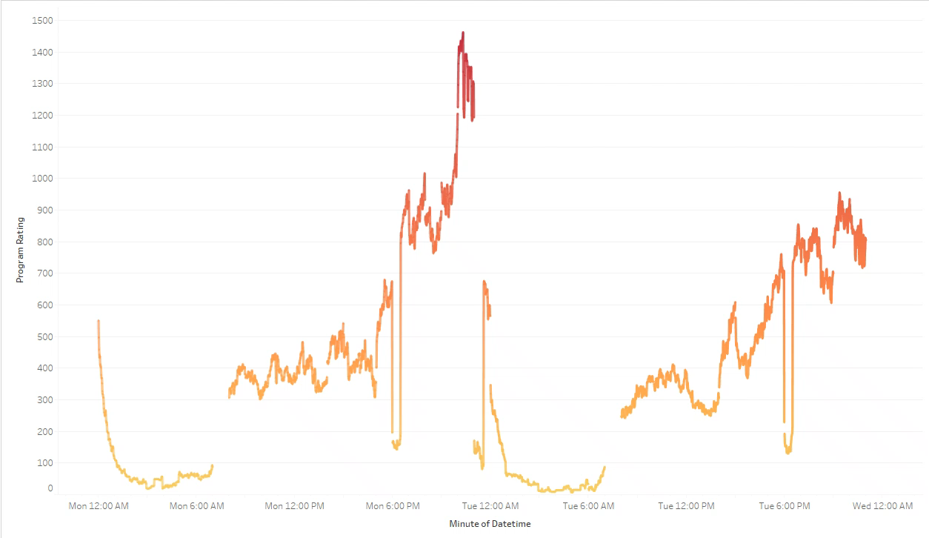
To see runtime rating performance please play the video
Time series Animation

Slide 10
Thank you…..!

